Slide 1
Slovak Stakeholder Consultation
Open Policy Analysis and Data Cooperation
Open Music Europe Consortium
Policy agenda: Dr Joost Poort (UvA) | Data coordination: Daniel Antal, CFA (Reprex)
Survey harmonisation: Dr James Edwards (SINUS) | Industry innovation: Magr. Tomáš Mikš (SOZA)
EUBA Building
2023.09.21

Slide 2
Dr Joost Poort: Policy Agenda

Slide 3
Measurements/Indicators
ID | Indicator description in Slovak policy document | Data source
2e | Reduction of investment gap in the culture sector compared to investment needs at baseline, which foresees a 640-million-euro excess investment till 2030. This is relevant for our Music economy and Sustainability pillars. | s.
2a | Share of value added of culture and creative industries in the value added of the economy, which is projected to grow at a higher rate than the Slovak economy. This is a key interest in our Music economy research. | Roč 1-01, Roč 2-01, KULT, LFS, harmonized Open Music Europe surveys.
2d, 2f | Share of own revenues, which are expected to grow. The growth of revenues in the music industry is a key target for all our research, including Innovation, too. | Roč 1-01, Roč 2-01, KULT, , harmonized Open Music Europe surveys.
SDG | Amount of revenue of economic units engaged in the business of in the field of creative industries (it is a component of 2a , 2c, 2d and can be measured together.) | See above.

Slide 4
Measurements/Indicators
ID | Indicator description in Slovak policy document | Data source
3b | Number of male and female employees in the cultural and creative industry. Number of self-employed persons in the culture and creative industries. These measurements are central to the Music economy pillar and the gender equality component of social sustainability is part of Open Music Europe. It is also an important meeting point with the Slovak strategic sustainable development goals (SDGs). | Roč 1-01, Roč 2-01, KULT, LFS, harmonized Open Music Europe surveys.
3a | Share of employment in culture and creative industries in the total economy is the most prioritized part of our measurement, because the higher level value added is mainly determined by labor input. | Same as 3b.
3d | Average income in culture and creative industries; number of industries lagging behind the national economy average value are part of our Music economy pillar. | Roč 1-01, Roč 2-01, KULT, LFS , harmonized Open Music Europe surveys.
SDG | Average wages of professional men and women in the cultural and creative industries as a proportion of the national average wage of university-educated men and women in the national economy | We’d like to consult on this indicator.

Slide 5
Measurements/Indicators
ID | Indicator description in Slovak policy document | Data source
SK SDG | Expenditure on cultural services as a share of total household expenditure (this is overlapping with our measurement targets in WP3 and the CAP survey and can be seen as a way to cross check earlier production side indicators.) | Roč 1-01, Roč 2-01, KULT, CAP, harmonized Open Music Europe surveys.
SK SDG | Share of expenditure on cultural services (goods and services related to individual and organised recreation and other leisure activities) of total expenditure households. | Same as 3b.
SK SDG | Share of public spending on culture on GDP. Public spending on culture as a share of GDP. This is a useful addition to measuring the demand side of the equation, specifically public demand. | Public administration data based on COFOG.
Further economic indicators will be suggested in the context of more specific topics and other strategic objectives of the Slovak cultural strategy in the Session 1 about Data Coordination.

Slide 6
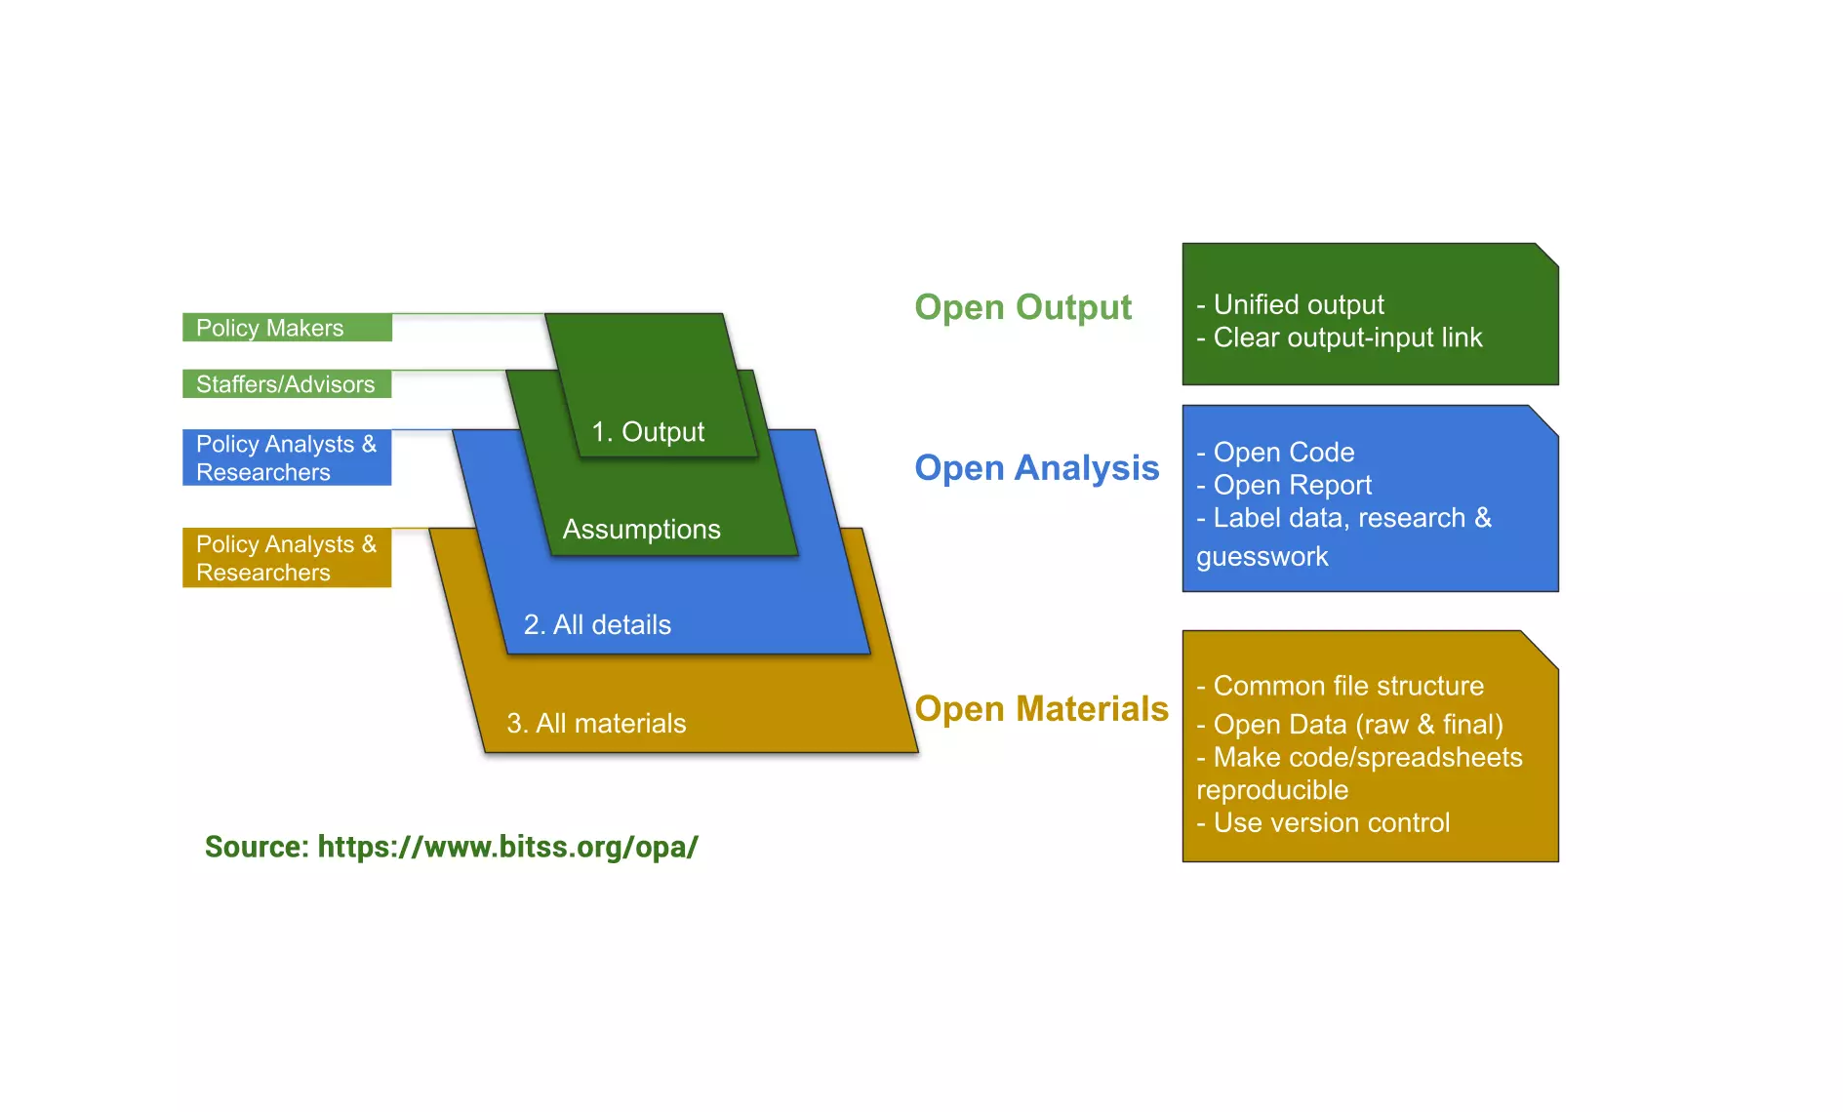
Open Policy Analysis
Open Materials: You do not only see our analysis and music industry KPIs, but also all the materials and assumptions use, even the software algorithms.
Open Materials: We write open source code that helps the creation of Music Industry satellite account. Our reports are open.
Open Materials: Open Data Directive (PSI-reuse), open statistics, our open science collections. Manuscripts. References. Living document.

Slide 7
Daniel Antal, CFA: Data Coordination

Slide 8
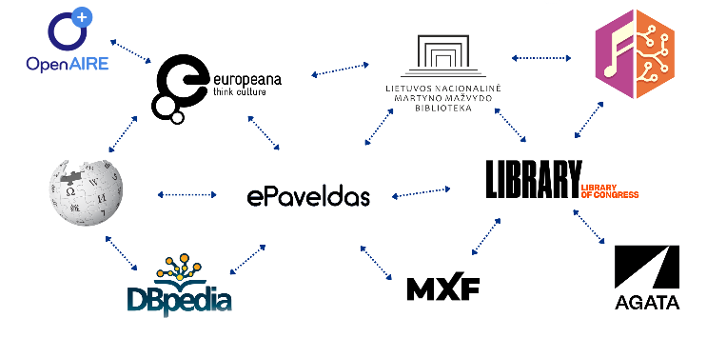






?
?
Data needs
Evidence needs for policy
SK Music Industry Register
Slovak Comprehensive Music Database
SK Statistical Business Register
SK Statistical Business Register
Census
Sample survey
Sample surveys
Registry survey
Extended Satellite Accounts for Music

Slide 9



EU Strategic Policy Agenda
Triple transition
Green: accounting for carbon and other environmental impacts in the value chain.
Digital: cloud based, AI-driven and automated machine-to-machine sales.
Social: sustainable for a just society, in music women and minorities.

Slide 10
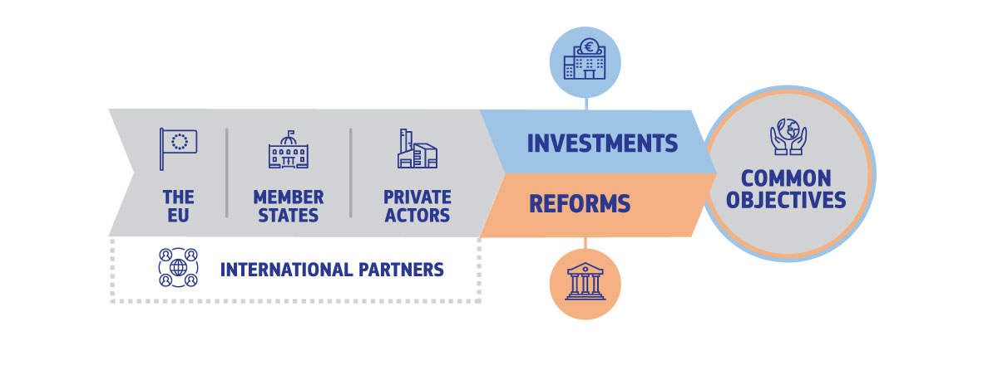
Triple Transition for Music Industry
The triple transition policies provide large public funding (EU budget + RFF) and redirected private funding for structural reforms necessary to make economic activities more sustainable and resilient.
The music industry with its relatively low environmental negative impact and potentially high positive social impact can benefit above-average from this new economic policy if it can provide evidence on how it creates value and uses natural and social resources.

Slide 11
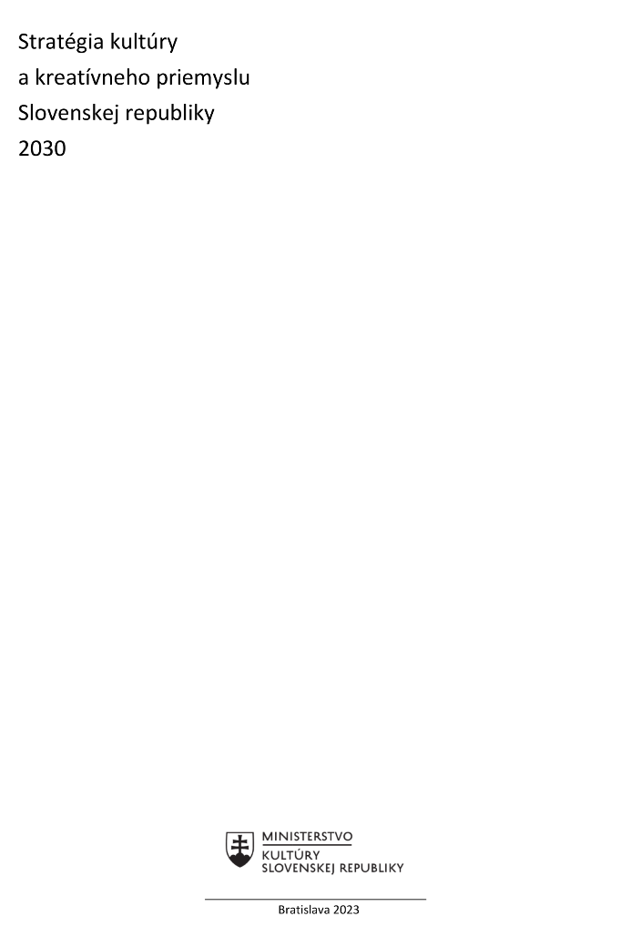

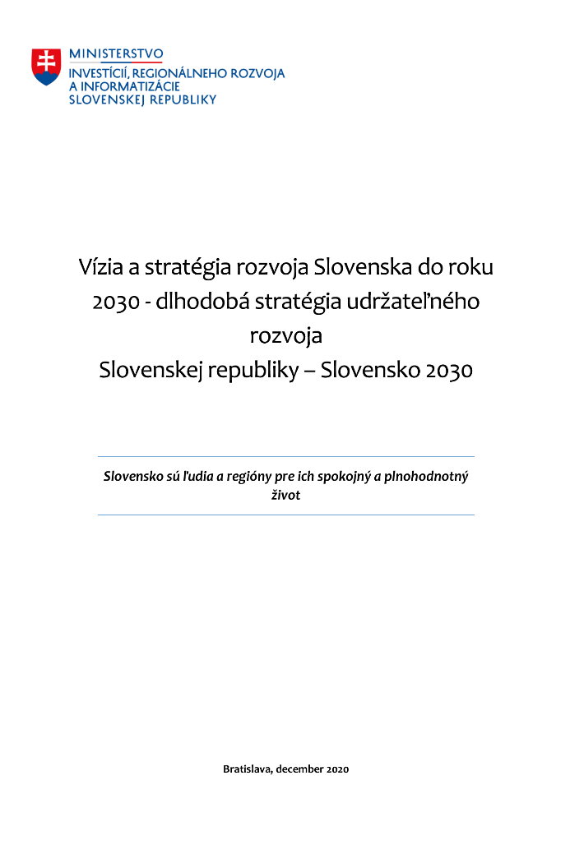
Slovak Policy Agenda

Slide 12
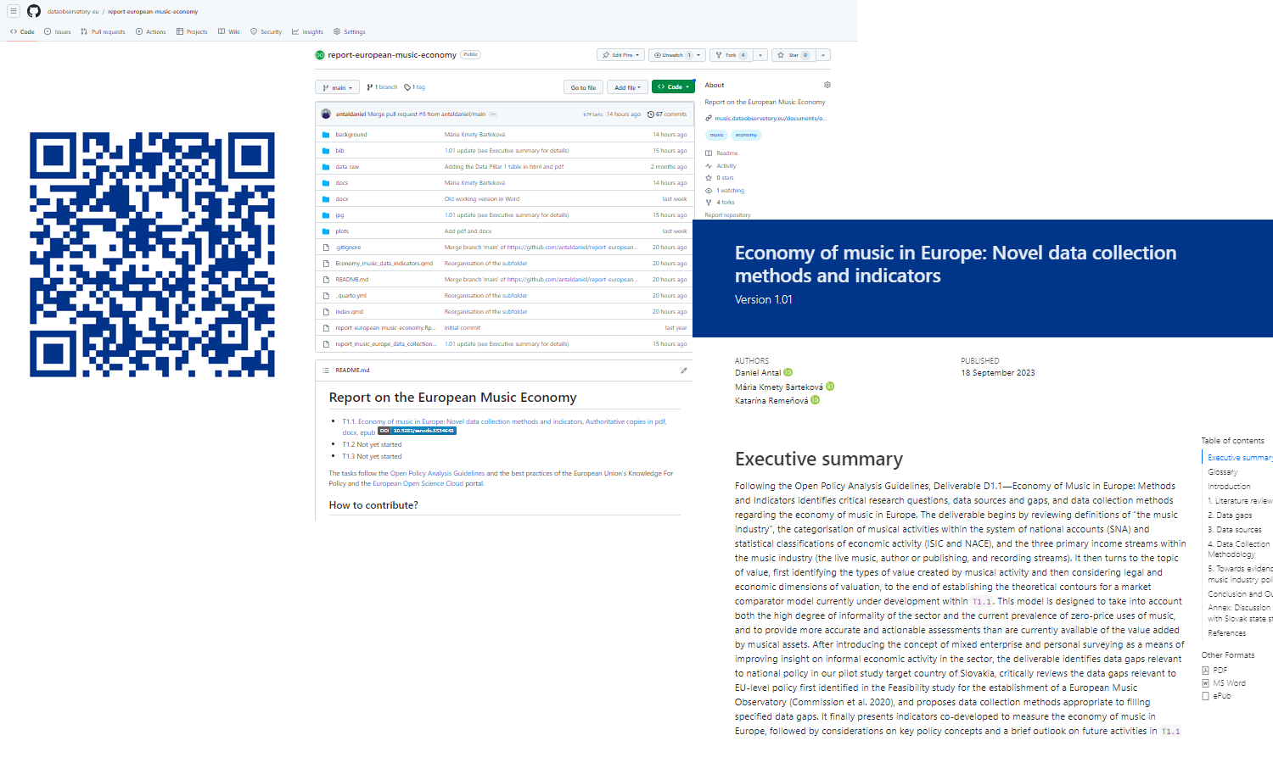
Open Policy Analysis
Open repository with all open materials, source code, links. https://github.com/dataobservatory-eu/report-european-music-economy
Website view with HTML, EPUB, PDF, (DOCX) versions
https://music.dataobservatory.eu/documents/open_music_europe/economy/report/report_music_europe_data_collection.html

Slide 13
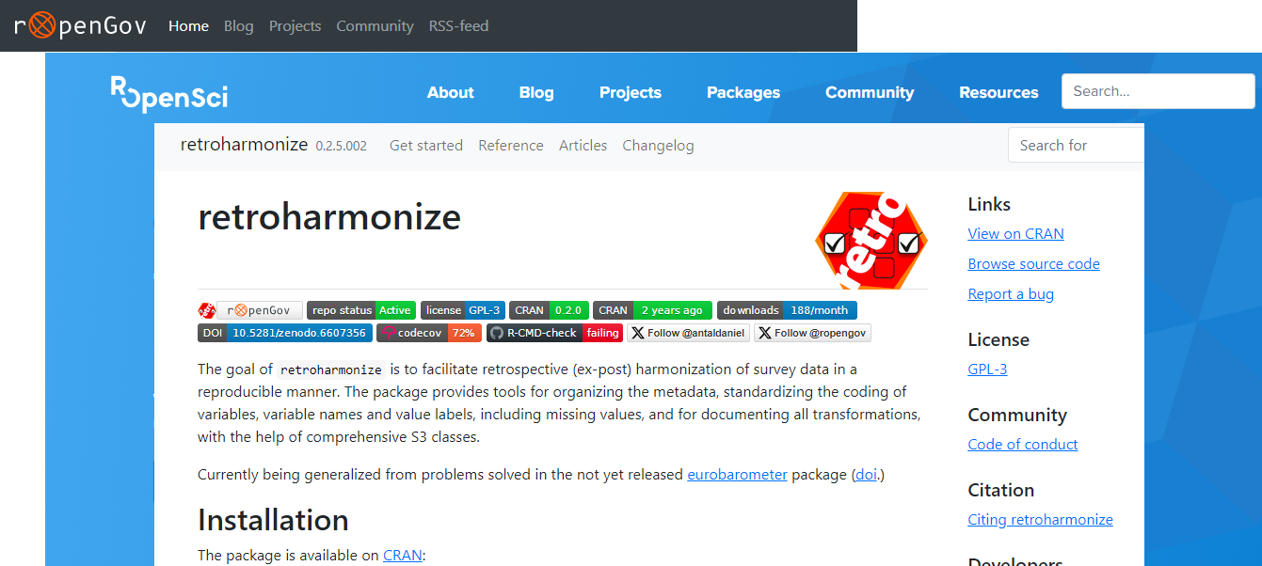
Open Policy Analysis
R is the computational language of statistics
ROpenSci and rOpenGov to transform science and policy analysis with reproducible research
iotables for economic/environmental analysis of SNA and satellite accounts
regions for creating regional statistics
retroharmonize for retrospective survey harmonisation
Our analysis is open. Our data is open. Open calculations are open. Our software code is open. We encourage review, suggestions, corrections in each step. Aim: Music Industry Satellite Accounts.

Slide 14


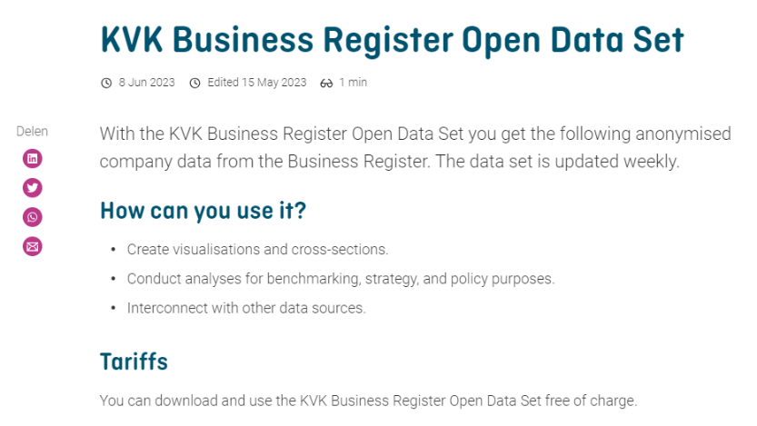
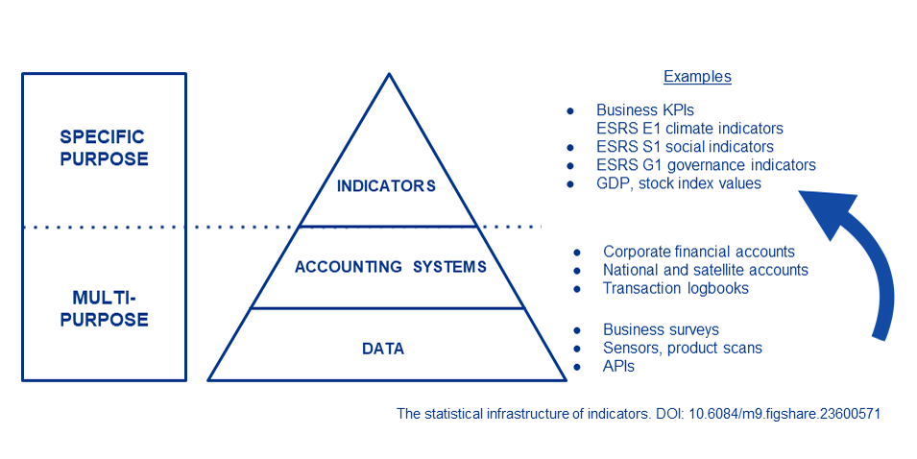
Open Data Infrastructure
A register is a complete list of the objects in a specific group of objects (music works, sound recordings) or population (musicians, music professionals, record labels, music publishers.)
An administrative register, such as the registers of SOZA and Hudonbe centrum are registers which were not originally created with a primary statistical purpose by a statistical authority.
The register-statistical processing means turning music registers as administrative sources into statistical registers.
Read more on this URL: here.
We follow the UN/EU Guidlelines on creating statistical business registers and their satellites
Example of open statistics not produced by statistical office (Dutch Chamber of Commerce)

Slide 15



Open Policy Analysis
Rights management
Music works Sound recordings
Slovak Comprehensive
Music Database SCMDb
Data synchronisation, coordination tool and register
Authors, performers
Groups of perfomers
Labels and publishers
Register-statistical processing to enable SCMDb for statistical use (follow UN/UNECE)
Slovak Music Industry Register
Detaching SBR Satellite outside official statistical system to satellite to allow scientific/business cooperation (follow UN/UNECE)
Slovak SBR Music Industry Satellite
SK CCI satellite accounts extended with music industry, GVA, GDP, employment statistics
Slovak CCI Satellite Accounts extended with Music
https://music.dataobservatory.eu/documents/open_music_europe/music-observatory-pillars/music-observatory-pillars.html

Slide 16
Dr James Edwards: Survey harmonisation

Slide 17
Contents
Why improve our data collection on music?
How can data be “harmonised”?
What relevant data exist on an SK and EU level?
What harmonized surveys will we conduct?
MSME and music professionals survey
Cultural access and participation survey
Listen Local pilot project (user onboarding)
Environmental, social, and governance sustainability reporting pilot project (enterprise self-assessment)
Annex: IKP indicators relevant to Open Music Europe WP3 Music, Society, and Citizenship

Slide 18
Why improve our data collection on music?
Cultural and creative sectors and industries (CCSIs) drive economic and non-economic value creation
GDP multipliers (music: 2.2x investment to outcome ratio) (IFPI, 2020)
Employment drivers (at least 2mil people employed in the EU)
Difficult-to-quantify adjacent effects (e.g., gastronomy, tourism, etc.)
CCSIs help shape our identities, values, and relationships (OECD, 2022)
CCSIs have a role in all Integrated Development Programmes of the Slovak Vision and Development Strategy 2030
Programme I, Resource conservation and development: Culture “preserves traditions, crosses borders, builds a value system, develops creativity, promotes communication and critical thinking, fosters tolerance, empathy, and a sense of beauty.”
Programme II, Sustainable use of resources: “The high value-added potentials of the cultural and creative industries are underutilized.”
Programme III, Community development: “Ensure the availability and maintenance of quality, modern and efficient […] cultural infrastructure”.
→ The topic of “music, society, and citizenship” is esp. relevant to all three Integrate Development Programmes

Slide 19
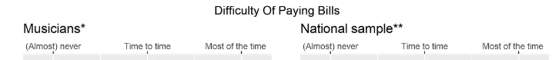
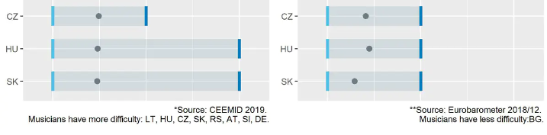
How can data be “harmonised”?
Data harmonisation simply means making different kinds of data interoperable, using a mix of planning and technical tools.
Ex ante harmonisation = designing a data collection instrument to harmonise with other instruments and/or previously collected data
Ex post harmonisation = making data interoperable, which were collected using non-harmonised instruments
Harmonised surveys often use questions borrowed/adapted from previous surveys
Example: the CEEMID survey adapted Eurobarometer questions to compare musicians’ data to the population:
XX
XX

Slide 20
What relevant survey data exist on an SK level?
Controller | Reporting unit | Surveys | Variables
Stat. Office SR | Enterprises | 26.1 Prices IaK; 26.2 Prices IaK; 32.2 Vol. IaK 1-01; 32.2 Vol. IaK 2-01 (Roč 1-01); 60.1 IaK 1-12 (Roč 2-01) | Prices; financial, cross-sectional, plant, sectoral, and local unit variables -- SK NACE 58-63
Stat. Office SR | NPOs | 67.1 NSNO 1-01 | Financial variables, etc.
Stat. Office SR | Households | 83.1 ICT HH 1-01 | ICT access and use
Stat. Office SR | Enterprises | 84.1 ICT ENT 2-01 | ICT access and use
MK SR | Cities; cultural orgs | 50.1 Kult 3-01 | Subjects/scope of cultural activities, economic indicators, etc.
MK SR | Music ensembles | 52.1 Kult 5-01 | Musical activities, economic indicators, etc.
MK SR | Radio licence holders | 54.1 Kult 7-01 | Radio programmes, economic indicators, etc.
MK SR | Music agencies, etc. | 62.1 Kult 16-01 | Number of events, type and type of event, etc.
MK SR | Recording prod., distrib. | 64.1 Kult 19-01 | Number of recordings by genre, etc., with economic indicators
MŠVVŠ SR | Ed. Institutions | 157. Schools 1-04; 158. Schools 2-04; 163. Schools; 164. Schools 12-01 | Number of staff; number of students / graduates by field
NOC SR | Individuals | Cultural participation survey 2018 | Value orientation; collective memory; attitudes toward culture / other cultures; leisure time; social networks
NOC SR | Individuals | Cultural participation survey 2019 | Interest in areas of culture; cultural consumption; accessibility of / participation in cultural activities; sources of information

Slide 21
What relevant survey data exist on an EU level?
Controller | Reporting unit | Surveys | Variables
Eurostat; SK Stat. Office | Households | Labour Force Survey | Occupation (NACE & ISCO), education (ISCED), earning, other demographics
Eurostat; SK Stat. Office | Individuals | Survey of Income and Living Conditions (SILC) | Living conditions. household financial variables, social exclusion, etc.; 2008 & 2015: cultural participation
Eurostat; SK Stat. Office | Individuals | Adult Education Survey | Occupation (NACE & ISCO), education (ISCED), other demographics; 2008 & 2011: cultural participation
Eurostat | Individuals | Harmonised European Time Use Survey (2020) | 522. Theatre and concerts; 711. Arts (visual, performing, literary); 831. Listening to radio or recordings
GESIS | Individuals | Eurobarometer 67.1 (Feb-Mar 2007) | Cultural participation; barriers to cultural participation; own artistic activities
GESIS | Individuals | Eurobarometer 79.2 (Apr-May 2013) | Cultural participation; barriers to cultural participation; cross-border cultural participation; own artistic activities; use of internet for cultural purposes (incl. consumption)
GESIS | Individuals | Eurobarometer 88.1 (Sept-Oct 2017) | Access to cultural heritage; importance of cultural heritage; involvement and participation in cultural heritage; barriers to participation; use of internet related to cultural heritage; value statements on cultural heritage; diversity and cultural heritage; intercultural role of cultural heritage; actors in cultural heritage; interest in cultural heritage

Slide 22
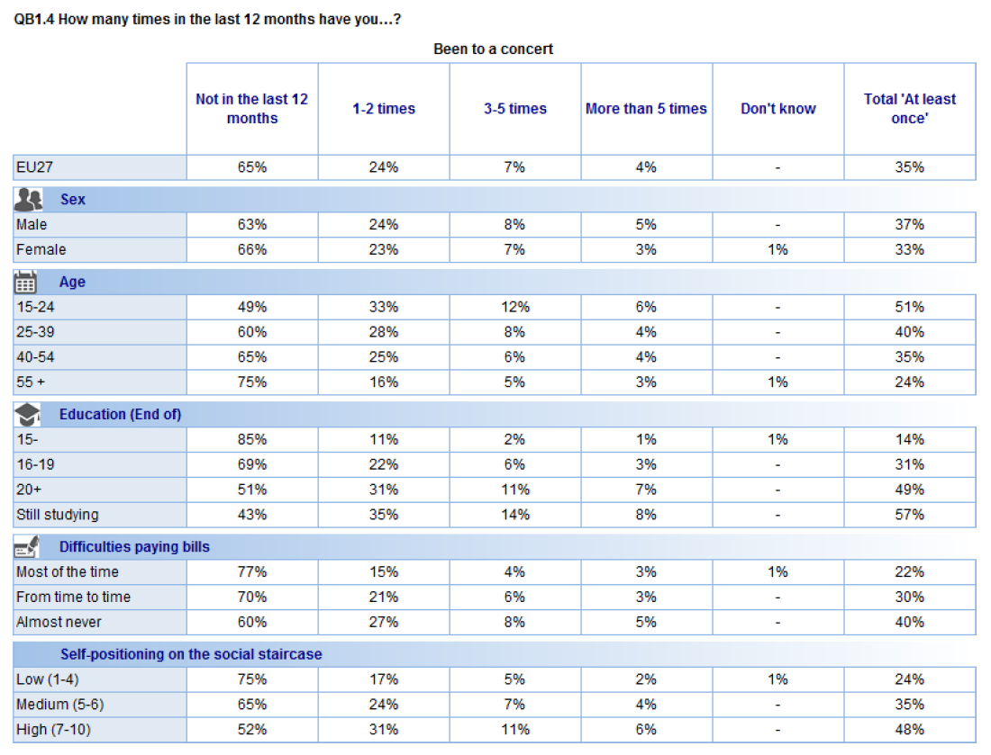
What relevant survey data exist on an EU level? – examples
Eurobarometer 79.2 (Apr-May 2013) – sociodemographic variables and concert attendance

Slide 23
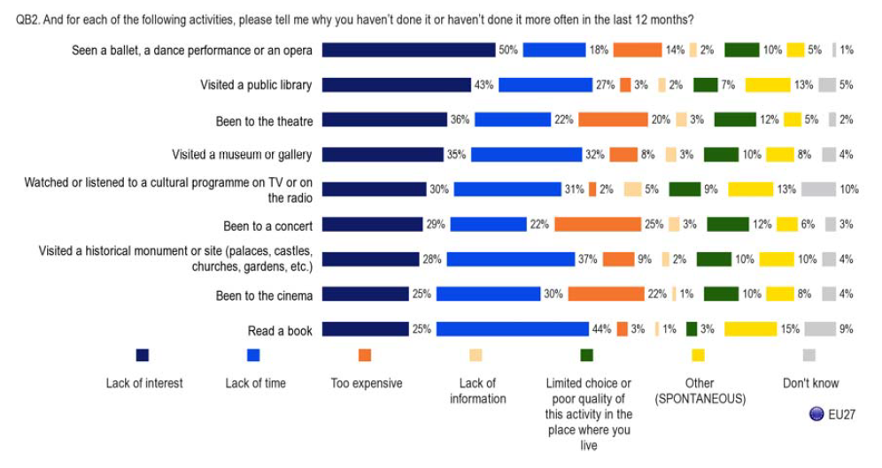
What relevant survey data exist on an EU level? – examples
Eurobarometer 79.2 (Apr-May 2013) – barriers to cultural participation

Slide 24
What harmonised surveys will Open Music Europe conduct?
Music MSME and professional surveys
Current and potential commercial activities and revenue streams → gain leverage in regulation / policymaking
Environmental, social, and governance attitudes and practices → gain benefits under forthcoming CSR Directive
Cultural access and participation / audience surveys
Musical activities – commercial (incl. music consumption) and non-commercial → better assess the total societal impact of music
Music, identity, and values → build up CCSIs as “societal seismographs” and “value(s) multipliers”
Other survey-type data collection: Listen Local and ESG reporting pilot projects
→ All of these use-cases can benefit from input and output harmonization on three levels:
Concepts (e.g., harmonization with statistical data and metadata exchange or SDMX guidelines)
Questions (e.g., borrowing questions from other surveys)
Codebook / outputs (e.g., ensuring that or data can be “synthesized” with data from other surveys)

Slide 25





MSME and music professional surveys (WP1)
Background
Target group
Music professionals, i.e., those who earn income from musical activities
Sample
n≥350 respondents per country in Bulgaria, Germany, Hungary, and Italy (best-effort)
Aims
Fill data gaps on music professionals (WP1, WP2)
Provide input for music valuation (WP1)
Provide data for toolkit development (WP4)
Contents
Overall musical activity, incl. education/training
Participation in and revenue from:
Commercial recordings, incl. revenue per channel/platform
Live performances and events
Other activities
Musical works, texts, recordings, and royalties
Grants/public funding
Sociodemographic variables
Optional: values-based or psychometric segmentation
Method
Computer-assisted web interviewing (CAWI), using:
Closed links sent by music organisations
Open link distributed on social media
Fieldwork
January 2024
Harmonisation
SK: KULT; Roč 1-01 / 2-01
Labour Force Survey
Survey on Income and Living Conditions (SILC)
CEEMID music professional surveys

Slide 26
Cultural access and participation survey (sustainability package)
Background
Target group
Resident population, age range to be determined
Sample
n=1.000 respondents per country in Bulgaria, Germany, Hungary, and Italy
Aims
Fill data gaps on music audiences (WP3)
Provide input for music valuation (WP1)
Provide testing and training data for toolkit development (WP4)
Contents
Music consumption, including piracy
Music in (online/offline) social networks, e.g., taste formation,
Amateur music production/participation
Music education
Attitudes toward music
Music and health/well-being
Music and values
Music and politics
Sociodemographic variables
Optional: values-based or psychometric segmentation
Method
To be determined.
ESSnet-Culture recommends a country-specific mix of computer-assisted personal surveying (CAPI) and computer-assisted telephone sampling (CATI) using a random sample.
However, during COVID-19, European Social Survey and Eurobarometer experimented with computer-assisted web interviewing (CAWI) using a random sample.
Fieldwork
January 2024
Harmonisation
SK: NOC CAP; CEEMID CAP
EU: Eurobarometer
Survey on Income and Living Conditions; Adult Education Survey; EUIPO & UVA/SSSA piracy surveys

Slide 27
Other data collection – Listen Local pilot project (diversity work package)
Background
Target group
Music professionals, i.e., those who earn income from musical activities
Sample
To be determined
Aims
Provide metadata for Listen Local (WP3), which is an initiative to increase the discoverability of local artists by music recommender systems through systematic metadata improvement
Contents
Personal information
Artist information, e.g., IDs, etc.
Information relevant to localisation, e.g., place of birth, places of residence, languages used, self-identification, etc.
Method
Computer-assisted web interviewing (CAWI), using:
Closed links sent by music organisations
Open link distributed on social media
Fieldwork
Open/continual
Harmonisation
SK: KULT; ZUC-NUT
EU: music information centres in the target countries use various data structures – interoperability will be a challenge.

Slide 28
Other data collection – ESG reporting pilot project (sustainability work package)
Background
Target group
Music industry MSMEs
Sample
To be determined – target = 3-4 MSMEs each in Bulgaria, Germany, Hungary, and Italy
Aims
Provide input for environmental, sustainability, and governance sustainability assessment (WP3)
Contents: management survey
Sociodemographic structure of the enterprise
Presence/planned ESG policies and measures
Contents: employee survey
Perceptions/experiences of equality and inclusion vs. bias (gender, ethnic, etc.)
Perceptions/experiences of corruption
Method
Computer-assisted web interviewing (CAWI)
Fieldwork
January 2024
Harmonisation
SK: KULT; Roč 1-01 / 2-01
EU: Labour Force Survey; Survey on Income and Living Conditions (SILC); Eurobarometer

Slide 29
IKP indicators relevant to Open Music Europe sustainability work package
ID | Indicator description in Slovak policy document | Data source
6a | Active cultural participation of the population/interested artistic activity | SK: NOC & CEEMID surveys EU: SILC 2015 (also SILC 2008, AES 2008 & 2011) OpenMusE: harmonised CAP
6b | Passive cultural participation of the population | SK: NOC & CEEMID surveys EU: SILC 2015 OpenMusE: harmonised CAP
6c | Public perception of the importance of culture | SK: NOC surveys EU: EB 88.1 OpenMusE: harmonised CAP
6f | Attendance at performing arts institutions → music | SK: KULT series EU: EB 79.2 OpenMusE: harmonised CAP
6g | Attendance at festivals | SK: KULT series OpenMusE: harmonised CAP
6h | Aggregate attendance at cultural institutions | SK: KULT series OpenMusE: harmonised CAP
7c | % of citizens who trust the media | EU: EB; ESS
7d | % of the population that has no reservations about a neighbour from another culture | EU: EVS
7g | % of the population who agree that other people can be trusted | EU: EVS; ESS

Slide 30
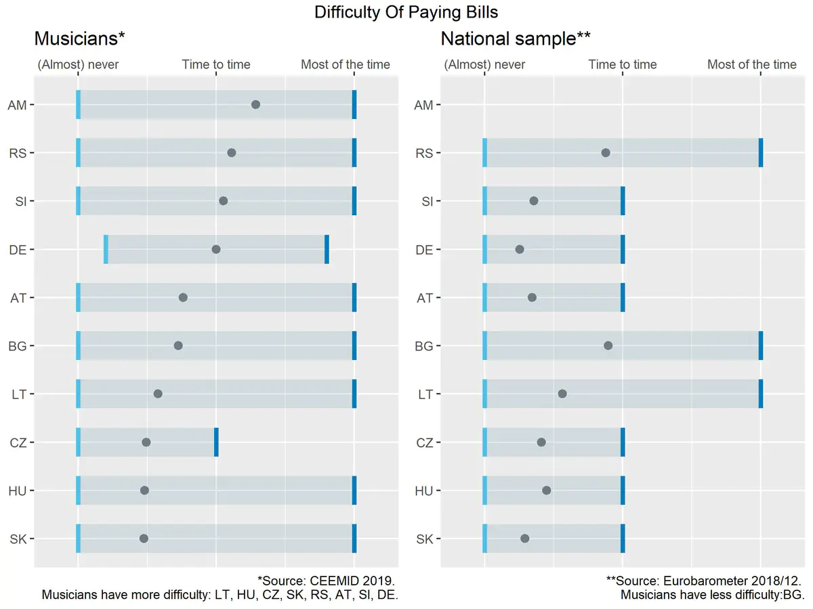
Survey harmonisation
Many indicators can be provided with international comparison (CZ, HU, PL, EU average, etc) with the means of retrospective survey harmonisation.
We can provide further, new indicators with international comparison with ex ante survey harmonisation.
Even more can be achieved with an effective data coordination and concept harmonisation, which allows data integration or data fusion from various ICET transaction sources, including so-called administrative source like tax records or royalty accounts.

Slide 31
SKMIR
Sample survey: randomly selected persons from register
Census: every person receives questions
Register-based survey: members of the register send data
Data suppliers are randomly invited
Data suppliers are included in the register
Reuse member data directly or via questionnaire
Own data collection mainly based on questionnaires

Slide 32
magr. Tomáš Mikš: Listen Local Slovakia

Slide 33
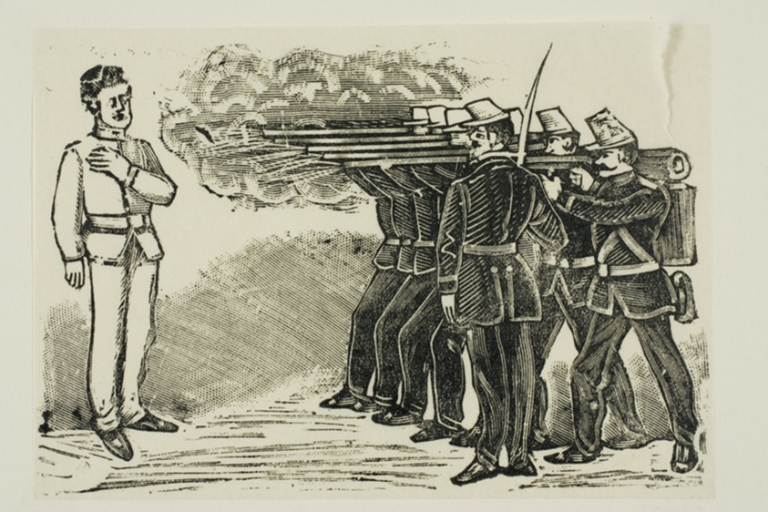
Why No Slovak Music Visibility?
SOZA cannot differentiate payments between its Slovak members and foreign authors.
A restaurant pulls the trigger if the money goes to Kosice, Bratislava or L.A. when they decide what music to play.
A radio stations pulls the trigger when it creates a playlist. Do they have everything to find relevant Slovak music?
On AI-driven global platforms there is no single bullet theory. We wanted to understand which bullet prevents Slovak songs to be played.

Slide 34
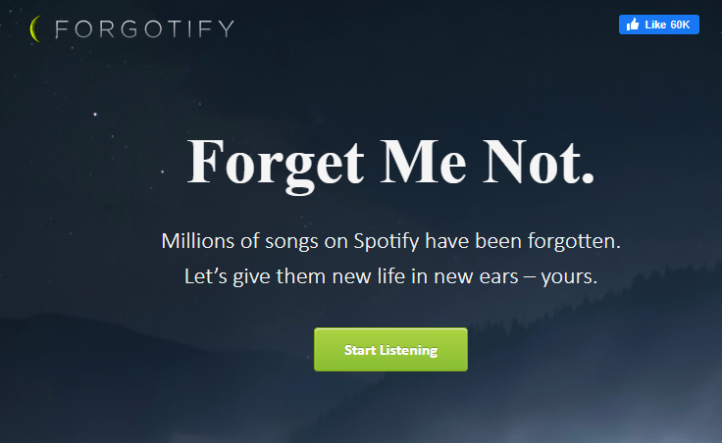
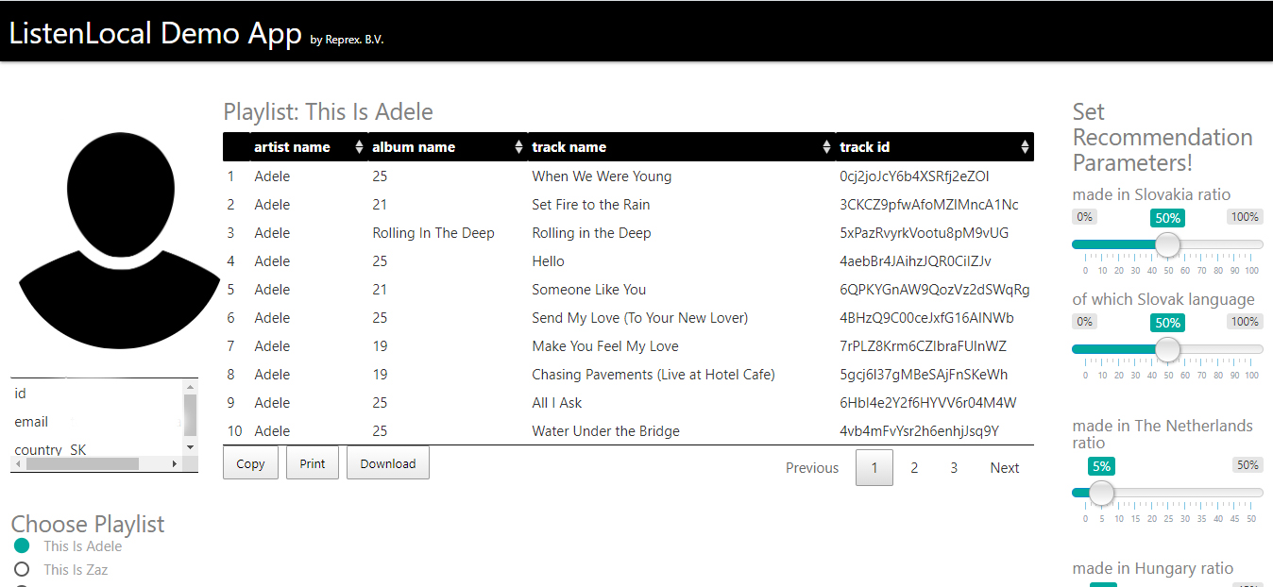
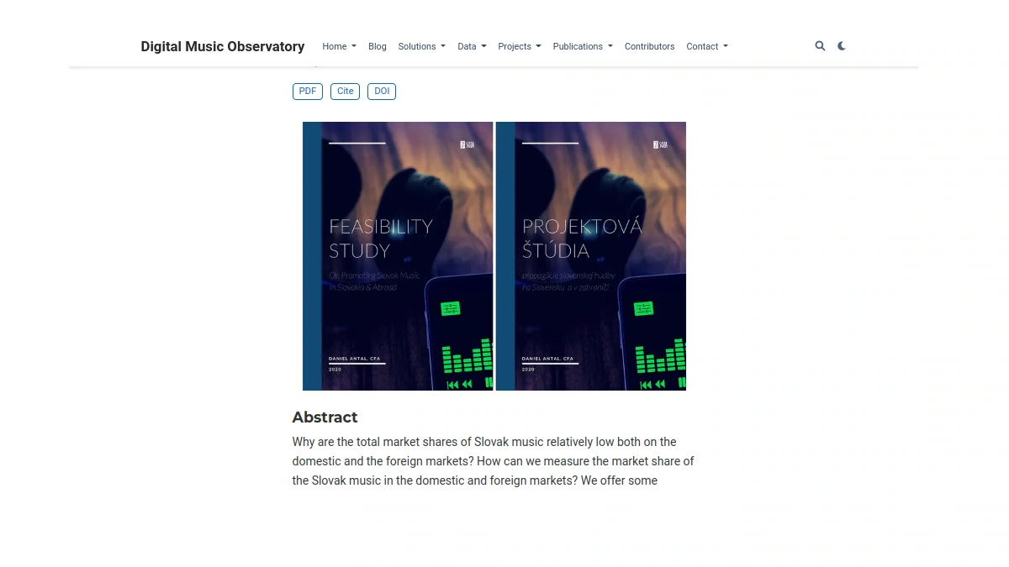

Listen Local 2020
1. Personal apps to localise Spotify/Deezer recommendations
2. Radio editors to fill their
Slovak quota.
3. Educators to playfully discover music of their town, region, Slovakia, Europe, not only global music centres.
4. Music export targets – new audience
Download the Slovak Music Industry report, the CEE report, and the Feasibility Study.

Slide 35
Listen Local – Music Policy Overlap
The goal of music policy is to develop the creation, presentation, and knowledge of music art.
Partial goals are:
1. to develop high-quality original creation in Slovakia
- via dignified and well financed culture with decent payments to rights holders
2. to enhance the accessibility of music and to provide a diverse range of music genres in Slovakia.
- via cooperation with HC, HF and others
3. to foster current and build new audiences of music and its presentation activities.
- better visibility = new audiencies
4. to develop presentation activities abroad.
- via complex linked open data web 3 compliant database with correct information in English language (Slovak Comprehensive Music Database)

Slide 36

Listen Local Lithuania
1. In Lithuania we designed the integration of Listen Local into the knowledge graph (internet of data)
connecting with global library, archive systems and databases that Spotify, Deezer, Apple or YouTube use.
2. We want to connect SOZA, Hudobné Centrum, Hudobny Fond, Slovak music libraries, labels, publishers with the rest of the world for machine-to-machine communication.

Slide 37
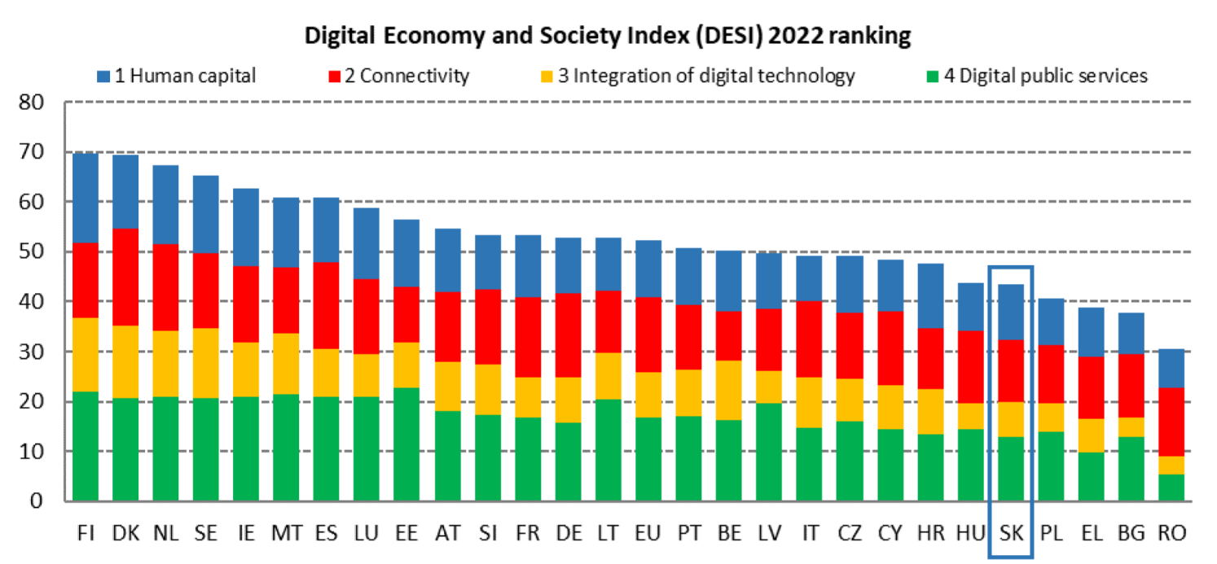


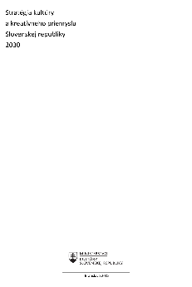
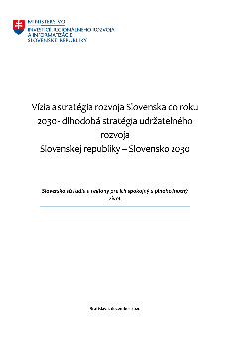

Listen Local Slovakia 2023
Support the Slovak music industry’s triple transition into a greener, more digital and socially more sustainable development path.
Provide tools to measure diversity and social sustainability for musicians and their audiences and affected communities, support women artists, minorities to remain visible on global platforms. Improve radio quotas into a goal-based music diversity and export program.
The music industry as a policy lab to improve Slovakia’s DESI score and to accelerate the digitisation of the SME sector.

Slide 38
Listen Local – Music Policy Overlap
Scientific advice and verification for some of their analysis. | Agreement on clear statement of research questions. Ex-post harmonisation with selected data assets. Value for money analysis, also for RFF and private funding.
Co-reate new datasets that complement their CCI Satellite Account system and add new data, which they do not possess with supporting surveys. | Cooperation on data coordination We will create a Slovak Music Industry Register and populate it with our (ex-ante harmonised, when possible) survey and administrative data about music. We expect the statistical stakeholders to turn this into a structural business register satellite, which would allow data coordination between their existing data and new data that would add.
Create measurements of many existing KPIs for which they do not have many historical values (retrospectively for comparison), and for 2024 or 2025 with new measurements (adding international comparators). | We would create ex-ante harmonised surveys and linkable datasets to existing Slovak survey datasets when they have no sufficient or distinguishable data on music. This can be used as a template for other industries that currently have no satellite account such as film. Ex-ante harmonise the sample frame (via the SBR satellite) and the questionnaire, collection timeframe, etc.
Break down their macro-level KPIs (for example, male and female employment) for the level of music industry and for enterprise/institution level. Actionable plans for institutions and industries with management control, transmission mechanism from their macro-level policy to institution/industry/enterprise level. | Our CAP survey as a vehicle for collecting datasets that they do not have on various KPIs for CCIs in general and a few select industries, focusing on music (but including some other arts—we always do that for better data linking with pre-existing CAPs). Historical, pan-European comparison of Slovakia’s values from AES, EU-SILC and Eurobarometer. Music professional survey for ex ante- interim assessment tool. We would like to access pre-existing statistical data, and in some cases microdata.

